Slide 1
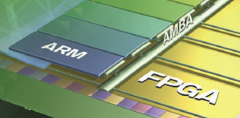

Lecture 7 LED Ping-Pong Game with Polling
References on Timer and Interrupts
Lab #6: LED Ping-Pong Game on Zybo
C code template
David Robinson’s Solution
pong_David_Robinson.h
pong_David_Robinson.c
GPIO Banks and XGPio drivers

Slide 2
ARM Timer References
Xilinx: Zynq-7000 All Programmable SoC, Technical Reference Manual, UG585 (v1.10) February 23, 2015
Altera: SoC FPGA ARM Cortex-A9 MPCore Processor Advance Information Brief, aib-01020, February 2012 Altera Corporation
Altera: Cyclone V Device Handbook, Volume 3: Hard Processor System Technical Reference Manual, November 2012 Altera Corporation
Xilinx Processor IP Library – scutimer v2_0 C:\Xilinx\SDK\2014.4\data\embeddedsw\XilinxProcessorIPLib\drivers\scutimer_v2_0
Altera : Introduction to the ARM® Processor Using Altera Toolchain, Altera Corporation University Program, April 2014

Slide 3
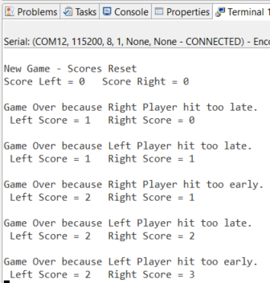
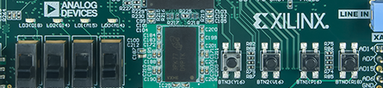
Lab #6: LED Ping Pong Game on Zybo
Reset Button: BTN2
Start Button: BTN1
Left Paddle: BTN3
Right Paddle: BTN0
Left paddle
Right Paddle

Slide 4
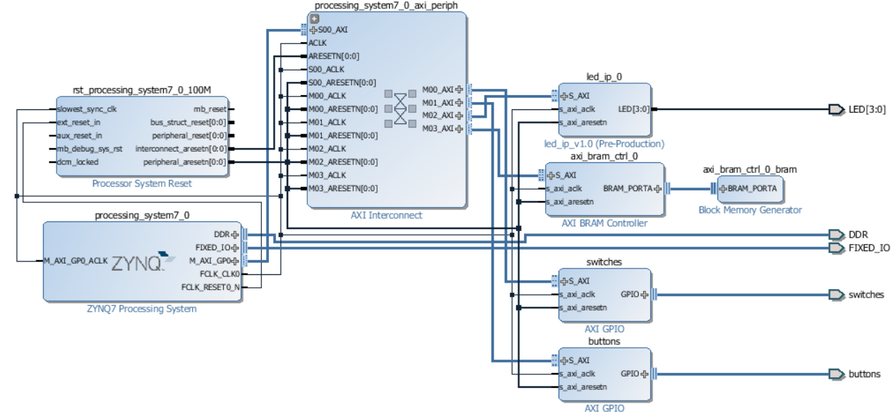
Lab #6: LED Ping Pong Game with Polling on Zybo

Slide 5
Design Philosophy
Always start with a skeleton code
Well structured and self documented code
Self documented variable names
No magic numbers or magic ports
Not about what to do but how to do it
Rules
Take turn to serve
Push buttons value 0b1000 0b0100 0b0010 0b0001
Ball positions 0b1000 0b0100 0b0010 0b0001
Left paddle = 0b1000
Right paddle = 0b0001
Slide Switches (ball speed)
SW3
SW2
SW1
SW0
Ball position
LED3
LED2
LED1
LED0
Push buttons
Left Paddle
Reset
Start
Right Paddle
Ball_Position={0b1000, 0b0100, 0b0010, 0b0001}
Move left
Move right

Slide 6
ASM Chart of Ping-pong Version 3: main()
Reset
Initialization
typedef enum
{LATEHIT, EARLYHIT, HIT, RESET, CONTINUOUS}
PlayStatus;
Wait for serve button
Serve
No
Right Serve
Left Serve
Who’s Turn
Yes
Take turn to serve
LeftPlay()
RightPlay()
Yes
HIT
Yes
HIT
No
No
Update Scores

Slide 7
ASM Chart of Ping-pong Version 3: LeftPlay subroutine
LeftPlay()
Note #1: RightPlay() code is symmetric to LeftPlay()
Note #2: Switch statement can be used to check push button state and print scores based on ball direction
ball =RIGHTPADDLE
Output ball value
Set timer speed
Start timer
return
ball=ball<<1
Status=EARLYHIT
No
No
Yes
Timer over
Yes
ButtonValue!=NO_PRESS
ball==
LEFTPADDLE
No
Status=RESET
Yes
Read player pushbuttons
No
ButtonValue==RESETBUTTON
Yes
Status=MISSED
ButtonValue==LEFTPADDLE
No
return
return
Yes
No
Timer over
Yes
Status=HIT
Direction=RIGHT

Slide 8
Lab #6: LED Ping Pong Game on Zybo Version 3: Template (page 1)
#include "xparameters.h"
#include "xgpio.h"
#include "led_ip.h"
// Include scutimer header file
#include "XScuTimer.h"
//====================================================
XScuTimer Timer;/* Cortex A9 SCU Private Timer Instance */
#define ONE_TENTH 32500000 // half of the CPU clock speed/10
typedef enum {OVER, START} GameStatus;
typedef enum {LEFT, RIGHT} Direction;
typedef enum {LATEHIT, EARLYHIT, HIT, RESET, CONTINUOUS} PlayStatus;
//push buttons
#define RESETBUTTON 0b0100
#define STARTBUTTON 0b0010
#define LEFTPADDLE 0b1000
#define RIGHTPADDLE 0b0001
//ball at serve
#define LEFT_SERVE 0b1000
#define RIGHT_SERVE 0b0001
#define NO_BALL 0b0000
void setTimer(void);
void RightPlay(PlayStatus *RightPlayerResult);
void LeftPlay(PlayStatus *LeftPlayerResult);

Slide 9
Lab #6: LED Ping Pong Game on Zybo Version 3: Template (page 2)
int psb_check, dip_check, Status;
XGpio dip, push;
// PS Timer related definitions
XScuTimer_Config *ConfigPtr;
XScuTimer *TimerInstancePtr = &Timer;
int scoreright, scoreleft;
int main (void)
{
unsigned int i;
PlayStatus LeftPlayerResult, RightPlayerResult;
GameStatus Game;
Direction BallDirection;
//configure push buttons and slide switches
// Initialize the timer
xil_printf("-- Start of the Ping Pong Program --\r\n");
scoreright = 0; scoreleft = 0;
xil_printf("Score Left = %d Score Right = %d\r\n", scoreright, scoreleft);
BallDirection = RIGHT; Game=OVER;
//turn off LEDs
LED_IP_mWriteReg(XPAR_LED_IP_0_S_AXI_BASEADDR, 0, NO_BALL);

Slide 10
Lab #6: LED Ping Pong Game on Zybo Version 3: Template (page 3)
while (1)
{
// check reset or start buttons
while(1) {
psb_check = XGpio_DiscreteRead(&push, 1);
switch (psb_check) {
case RESETBUTTON://reset game
xil_printf("\n\rNew Game - Scores Reset\r\n");
Game=OVER;
scoreright = 0; scoreleft = 0;
xil_printf("Score Left = %d Score Right = %d\r\n", scoreright, scoreleft);
//turn on all LEDs
LED_IP_mWriteReg(XPAR_LED_IP_0_S_AXI_BASEADDR, 0, ~NO_BALL);
for(i=0;i<30000000;i++);
while(psb_check == RESETBUTTON)
psb_check = XGpio_DiscreteRead(&push, 1);
//turn off all LEDs
LED_IP_mWriteReg(XPAR_LED_IP_0_S_AXI_BASEADDR, 0, NO_BALL);
for(i=0;i<30000000;i++); break;
case STARTBUTTON:
Game=START;/ /start game
if(BallDirection==RIGHT) BallDirection=LEFT; else BallDirection = RIGHT; break;
default: Game=OVER; break;
}
if(Game==START) break;
}

Slide 11
Lab #6: LED Ping Pong Game on Zybo Version 3: Template (page 4)
//play pingong game
while(Game==START) {
if(BallDirection==RIGHT) {
RightPlayerResult = CONTINUOUS;
RightPlay(& RightPlayerResult);
if(RightPlayerResult==HIT) BallDirection=LEFT;
else Game=OVER;
}
else {
LeftPlayerResult = CONTINUOUS;
LeftPlay(& LeftPlayerResult);
if(LeftPlayerResult==HIT) BallDirection=RIGHT;
else Game=OVER;
}
} //end while(Game==START)
//update score after the game
switch(BallDirection) {
case RIGHT:
scoreleft++;
//display how the game was played on Terminal
break;
case LEFT:
scoreright++;
//display on Terminal how the game was lost.
}
xil_printf(" Left Score = %d Right Score = %d\r\n", scoreleft, scoreright);
}//while(1)
} //main()

Slide 12
Lab #6: LED Ping Pong Game on Zybo Version 3: Template (page 5)
//ball moves to the right
void RightPlay(PlayStatus *RightPlayerStatus)
{
char ball;
ball = LEFT_SERVE;
while(*RightPlayerStatus == CONTINUOUS) {
//The ball moves from left to right
} //end while(*RightPlayerStatus == CONTINUOUS)
} //end RightPlay()
//ball moves to the left
//symmetric to RightPlay()
void LeftPlay(PlayStatus *LeftPlayerStatus)
{
char ball;
ball = RIGHT_SERVE;
while(*LeftPlayerStatus == CONTINUOUS) {
} //end while(*LeftPlayerStatus == CONTINUOUS)
} //end LeftPlay()
void setTimer(void){
// Read dip switch values
// Load timer with delay in multiple of ONE_TENTH
//start timer
} //end setTmer()

Slide 13
David Robinson’s Solution: pong.h (no magic number or port)
#ifndef PONG_H_
#define PONG_H_
#define ONE_TENTH 32500000
#define START_BUTTON_MASK 0x0002
#define RESET_BUTTON_MASK 0x0004
#define BALL_LEFT_START_POSITION 8
#define BALL_RIGHT_START_POSITION 1
#define BALL_START_DIRECTION RIGHT
#define LEFT_PLAYER_NAME "Left Player"
#define LEFT_PLAYER_POSITION 8
#define RIGHT_PLAYER_NAME "Right Player"
#define RIGHT_PLAYER_POSITION 1
#define PLAYER_START_SCORE 0
#define LEDS_OFF 0
#define INPUT 0xffffffff
typedef enum {
LEFT,
RIGHT
} ball_direction;
typedef enum {
NO_RESET,
RESET
} reset;
typedef enum {
MISS,
EARLY,
HIT
} hit_status;
typedef struct {
int speed;
ball_direction direction;
ball_direction serve_direction;
int position;
} ball;
typedef struct {
int score;
int position;
hit_status ;
char name[20];
} player;
#endif /* PONG_H_ */

Slide 14
David Robinson’s Solution: main() in pong.c (less than a page)
int main(void) {
XGpio buttons, switches;
XGpio_Initialize(&buttons, XPAR_BUTTONS_DEVICE_ID);
XGpio_Initialize(&switches, XPAR_SWITCHES_DEVICE_ID);
XGpio_SetDataDirection(&buttons, 1, INPUT);
XGpio_SetDataDirection(&switches, 1, INPUT);
XScuTimer timer;
XScuTimer_Config *timer_config = XScuTimer_LookupConfig(XPAR_PS7_SCUTIMER_0_DEVICE_ID);
int status = XScuTimer_CfgInitialize(&timer, timer_config, XPAR_PS7_SCUTIMER_0_BASEADDR);
if(status != XST_SUCCESS) {
xil_printf("Timer init() failed\r\n");
return XST_FAILURE;
}
while(1) {
play_pong(&buttons, &switches, &timer);
}
return 0;
}
//Lab #6 Pingpong Game with Zybo
//David M. Robinson
//3-25-2016
#include <strings.h>
#include <stdbool.h>
#include "xparameters.h"
#include "xgpio.h"
#include "led_ip.h"
#include "xscutimer.h"
#include "pong.h"

Slide 15
David Robinson’s Solution: play_pong()
play_pong()
Declare two players
Current_player=right_player
Initialize players, ball, switches
Set up timer
Check Start Button
No
Start?
Yes
Display ball
Set ball speed
Check button press of current player for one time period
Move ball once
No
No
HIT
No
EARLY
MISS
Game over
Yes
Yes
Yes
Switch current player
Switch ball direction
Set initial ball position
Update scores
For current player
Switch server

Slide 16
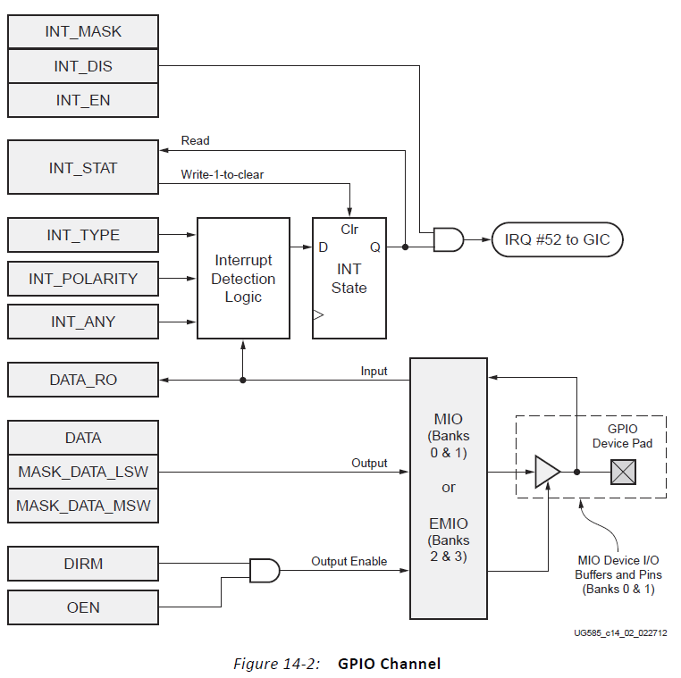
EMIO - Bank 2 and Bank 3 of GPIO: simply wires between PL and PS
The register interface for the EMIO banks is the same as for the MIO banks
However, the EMIO interface is simply wires between the PS and the PL.
The inputs wires from the PL are unrelated the OEN register.
The inputs can be read from the DATA_RO register when DIRM is set to 0, making it an input.
The output wires are not 3-state capable, so they are unaffected by OEN.
The value to be output is programmed using the DATA, MASK_DATA_LSW, and MASK_DATA_MSW registers. DIRM must be set to 1, making it an output.

Slide 17
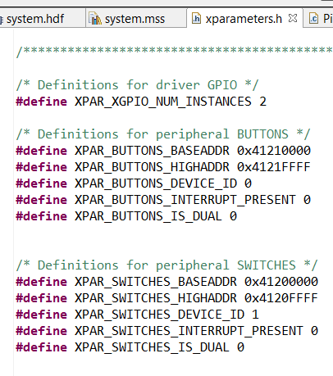
Definition of a XGPio Port: DeviceID, BaseAddress, Channel
typedef in xgpio.h
Xgpio_Config
Xgpio
DeviceID in xparameters.h
BUTTONS
SWITCHES
Channel 1 or 2
typedef struct {
u16 DeviceId; /* Unique ID of device */
u32 BaseAddress; /* Device base address */
int InterruptPresent; /* Are interrupts supported in h/w */
int IsDual; /* Are 2 channels supported in h/w */
} XGpio_Config;
typedef struct {
u32 BaseAddress; /* Device base address */
u32 IsReady; /* Device is initialized and ready */
int InterruptPresent; /* Are interrupts supported in h/w */
int IsDual; /* Are 2 channels supported in h/w */
} XGpio;

Slide 18
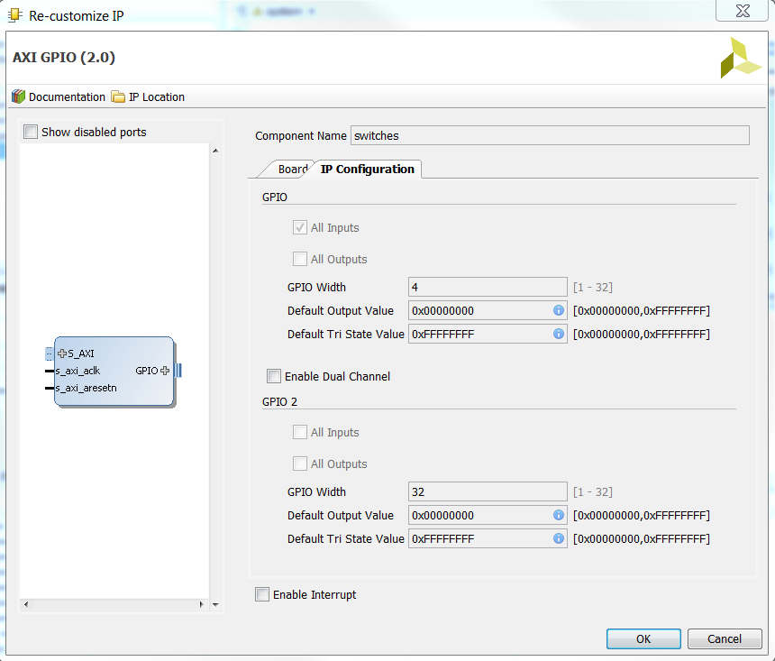
Channel 1 or 2
AXI GPIO has two channels of 32 bits each, GPIO 1 is always enabled
2nd channel, GPIO 2, can be enabled or disabled

Slide 19
xgpio.c: initialization and Level 1 Driver Functions
int XGpio_Initialize(XGpio *InstancePtr, u16 DeviceId);
XGpio_Config *XGpio_LookupConfig(u16 DeviceId);
int XGpio_CfgInitialize(XGpio *InstancePtr, XGpio_Config * Config, u32 EffectiveAddr);
void XGpio_SetDataDirection(XGpio *InstancePtr, unsigned Channel, u32 DirectionMask);
u32 XGpio_GetDataDirection(XGpio *InstancePtr, unsigned Channel);
u32 XGpio_DiscreteRead(XGpio *InstancePtr, unsigned Channel);
void XGpio_DiscreteWrite(XGpio *InstancePtr, unsigned Channel, u32 Mask);

Slide 20
XGpio_Initialize(), XGpio_SetDataDirection(), XGpio_DiscreteRead()
XGpio_Initialize(&dip, XPAR_SWITCHES_DEVICE_ID);
XGpio_SetDataDirection(&dip, 1, 0xffffffff);
psb_check = XGpio_DiscreteRead(&push, 1);

Slide 21
XGpio_Initialize(&dip, XPAR_SWITCHES_DEVICE_ID);
In file xgpio_sinit.c
InstancePtr is a pointer to an XGpio instance
DeviceId is the unique id of the device controlled by this Xgpio instance. Passing in a device id associates the generic Xgpio instance to a specific device, as chosen by the caller or application developer.
int XGpio_Initialize(XGpio * InstancePtr, u16 DeviceId)
{
XGpio_Config *ConfigPtr;
Xil_AssertNonvoid(InstancePtr != NULL);
ConfigPtr = XGpio_LookupConfig(DeviceId);
if (ConfigPtr == (XGpio_Config *) NULL) {
InstancePtr->IsReady = 0;
return (XST_DEVICE_NOT_FOUND); }
return XGpio_CfgInitialize(InstancePtr, ConfigPtr,
ConfigPtr->BaseAddress);
}

Slide 22
XGpio_CfgInitialize(XGpio * InstancePtr, XGpio_Config * Config, u32 EffectiveAddr)
EffectiveAddr is the device base address in the virtual memory address space
int XGpio_CfgInitialize(XGpio * InstancePtr, XGpio_Config * Config,
u32 EffectiveAddr)
{
Xil_AssertNonvoid(InstancePtr != NULL);
/* * Set some default values. */
#if (XPAR_XGPIO_USE_DCR_BRIDGE != 0)
InstancePtr->BaseAddress = ((EffectiveAddr >> 2)) & 0xFFF;
#else
InstancePtr->BaseAddress = EffectiveAddr;
#endif
InstancePtr->InterruptPresent = Config->InterruptPresent;
InstancePtr->IsDual = Config->IsDual;
/* Indicate the instance is now ready to use, initialized without error*/
InstancePtr->IsReady = XIL_COMPONENT_IS_READY;
return (XST_SUCCESS);
}

Slide 23
XGpio_SetDataDirection()
Ptr is a pointer to an XGpio instance to be worked on.
Channel contains the channel of the GPIO (1 or 2) to operate on.
DirectionMask is a bitmask specifying which discretes are input and which are output. Bits set to 0 are output and bits set to 1 are input.
void XGpio_SetDataDirection(XGpio * InstancePtr, unsigned Channel,
u32 DirectionMask)
{
Xil_AssertVoid(InstancePtr != NULL);
Xil_AssertVoid(InstancePtr->IsReady == XIL_COMPONENT_IS_READY);
Xil_AssertVoid((Channel == 1) ||
((Channel == 2) && (InstancePtr->IsDual == TRUE)));
XGpio_WriteReg(InstancePtr->BaseAddress,
((Channel - 1) * XGPIO_CHAN_OFFSET) + XGPIO_TRI_OFFSET,
DirectionMask);
}

Slide 24
XGpio_DiscreteRead()
InstancePtr is a pointer to an XGpio instance to be worked on.
Channel contains the channel of the GPIO (1 or 2) to operate on.
Return Current copy of the discrete register.
u32 XGpio_DiscreteRead(XGpio * InstancePtr, unsigned Channel)
{
Xil_AssertNonvoid(InstancePtr != NULL);
Xil_AssertNonvoid(InstancePtr->IsReady == XIL_COMPONENT_IS_READY);
Xil_AssertNonvoid((Channel == 1) ||
((Channel == 2) && (InstancePtr->IsDual == TRUE)));
return XGpio_ReadReg(InstancePtr->BaseAddress,
((Channel - 1) * XGPIO_CHAN_OFFSET) +
XGPIO_DATA_OFFSET);
}

